Slide 1
Cervical Spine Fracture Detection
with Deep Learning
Team Members:
Ruxiao Duan
Qihua Gong
Weishen Qi
Tingying Lu
Yifan Zhou

Slide 2
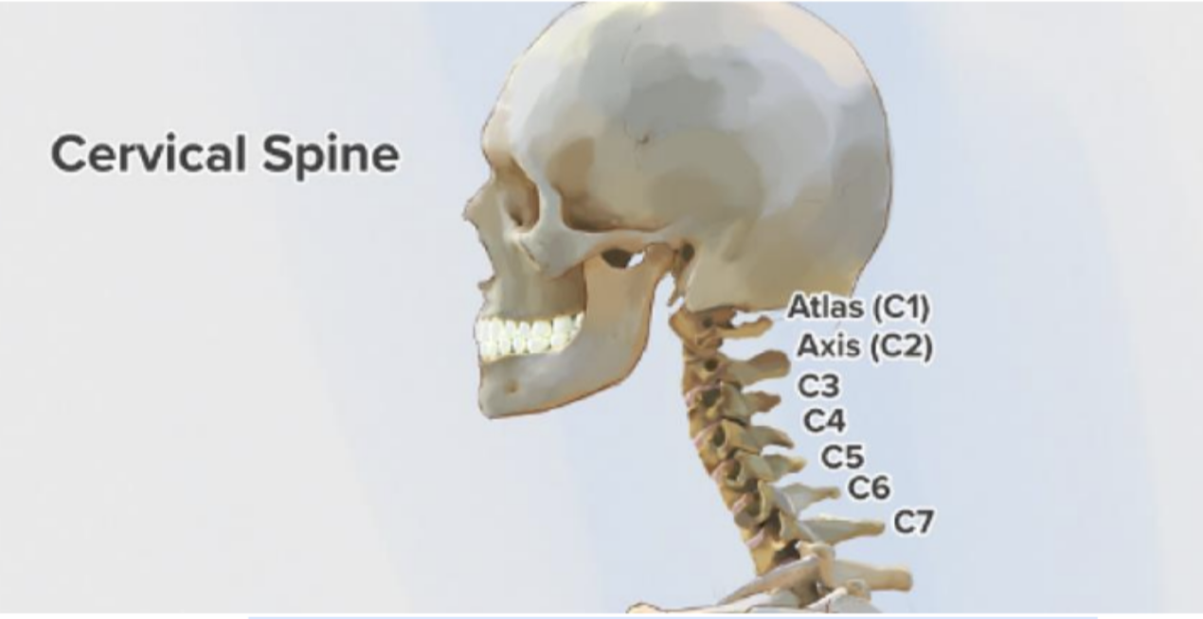
Seven Vertebrae on Human Cervical Spine

Slide 3
Project Objective
Leverage deep learning techniques to identify fractures on the human cervical spine
Locate fractured part in c1-c7
Predict fracture for a patient overall

Slide 4



Target Benefit Group
Patients who has spinal cord injuries
Help doctor reduce their workload using machine learning method

Slide 5
Dataset
Radiological Society of North America (RSNA)
American Society of Neuroradiology (ASNR)
American Society of Spine Radiology (ASSR)
X-ray images collect from 12 sites globally, including approximately 3000 CT studies.

Slide 6
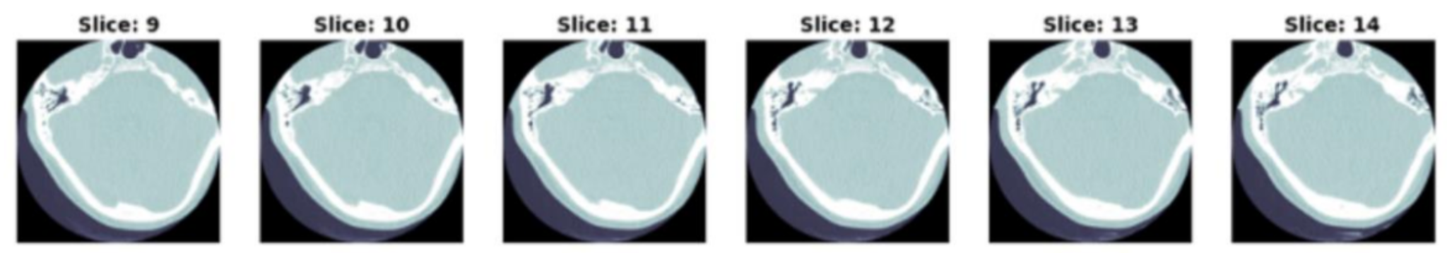
Overview of dataset
train_images/ (2019 folders, each for a patient)
test_images/ (3 folders, each for a patient)
train.csv (metadata for the training set, 2019 patients)
test.csv (metadata for the test set, size: 3 rows x 3 cols)
train_bounding_boxes.csv (bounding boxes for a subset of the training set, 239 patients, 7217 slices)
segmentations/ (87 folders, pixel level annotations for a subset of the training set)

Slide 7
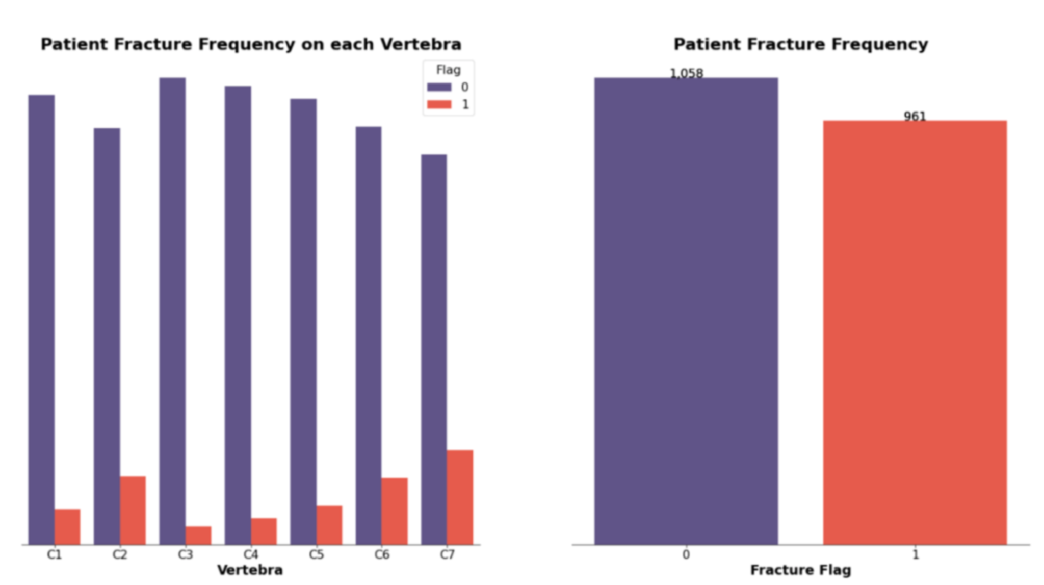
More on Dataset

Slide 8
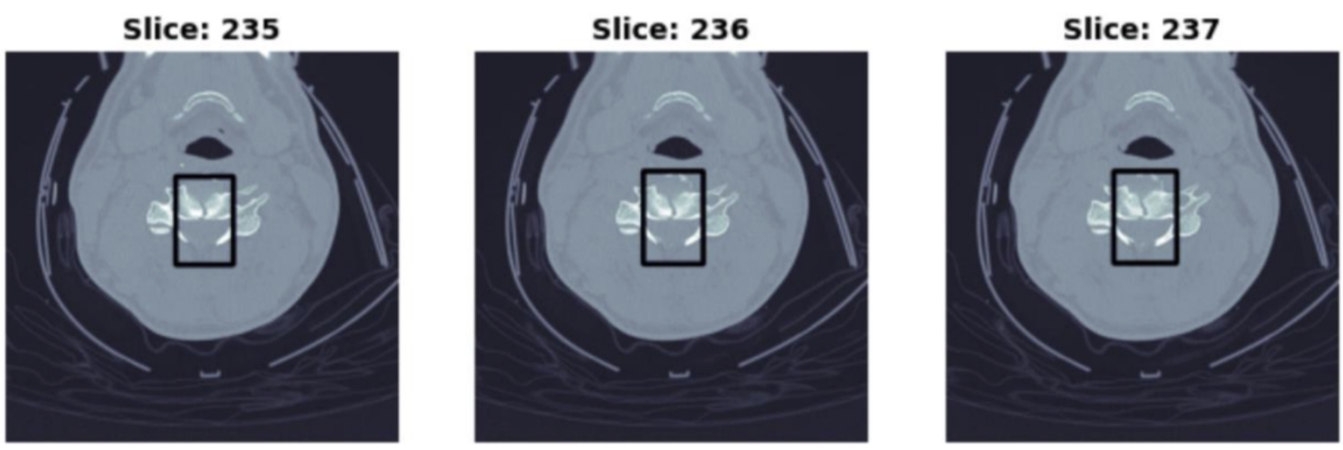
Fracture Bounding Boxes

Slide 9
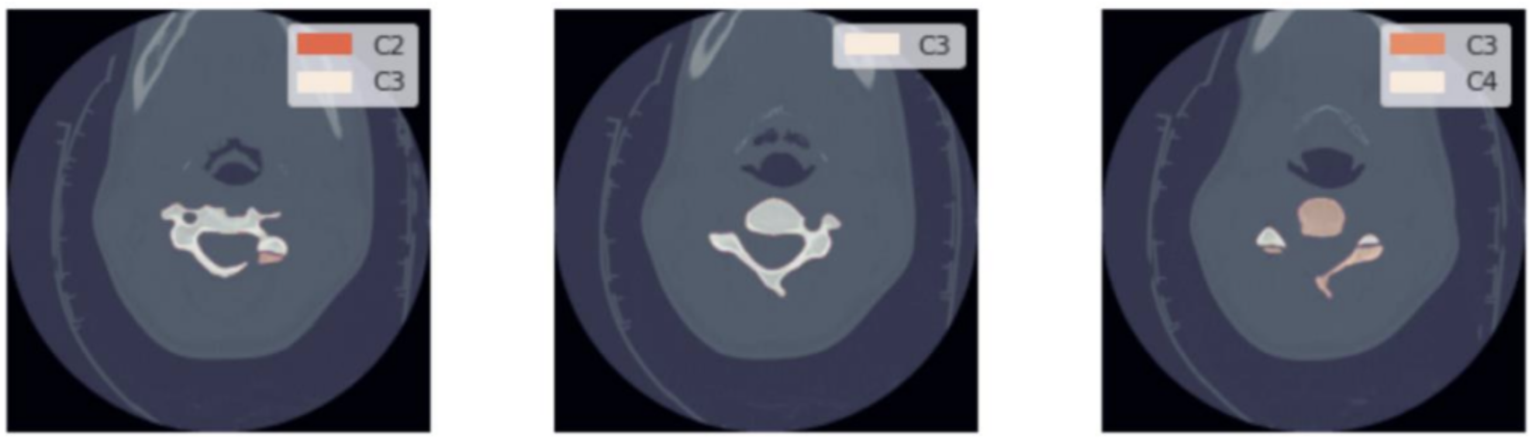
Slices with a Pixel-level Vertebrae Annotation

Slide 10

2-D animation of the Segmentation and Annotation
C1
C2
C3
C4
C5
C6
C7

